Slide 1
Computing on the Open Science Grid
Submit Locally, Run Globally

Slide 2
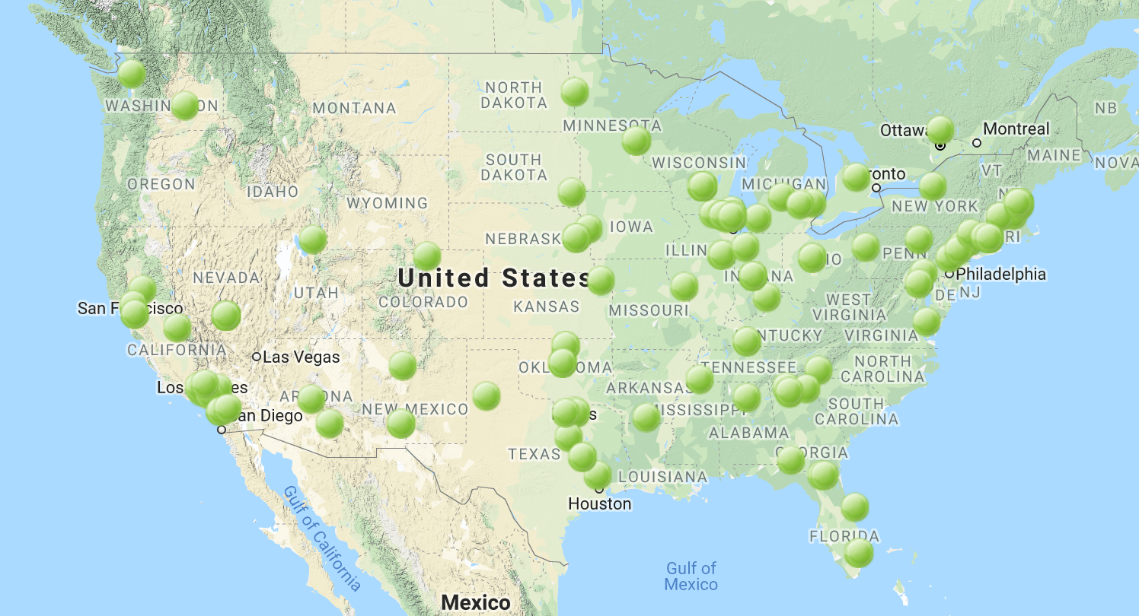
What is the Open Science Grid (OSG)?
The Open Science Grid is a distributed computing network, with users and computers across the United States
100 sites • 420M jobs • 1.5B compute hours
in the past year

Slide 3
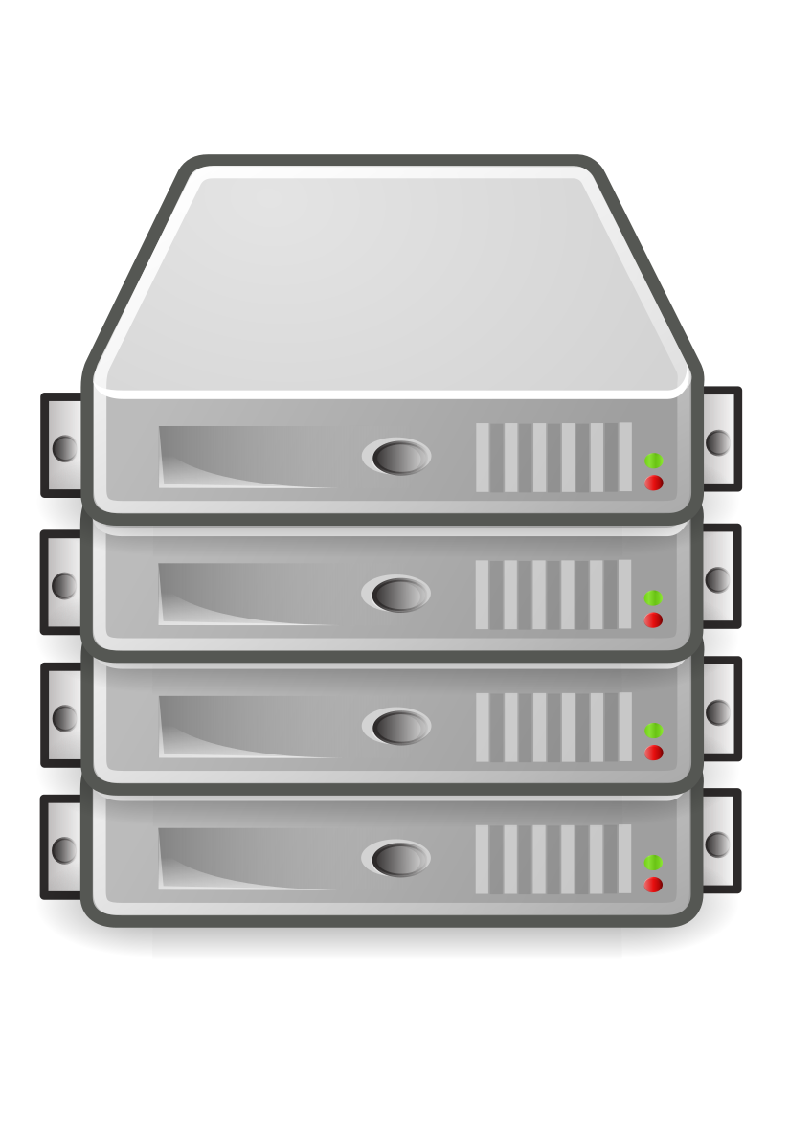

How does it work?
1.
Get an account
OSG member organizations
OSG Connect
(anyone at a US institution/center)
local access
(through a project or university)
3.
Jobs run on
OSG
2.
Submit jobs
AWS*
XSEDE*
*talk to the OSG team for details

Slide 4


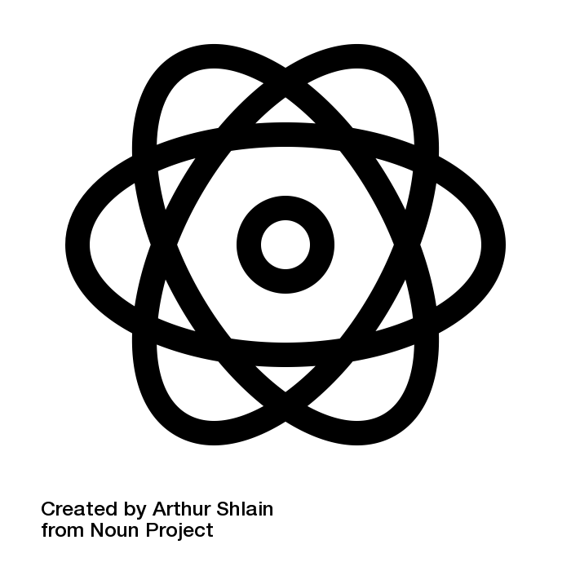
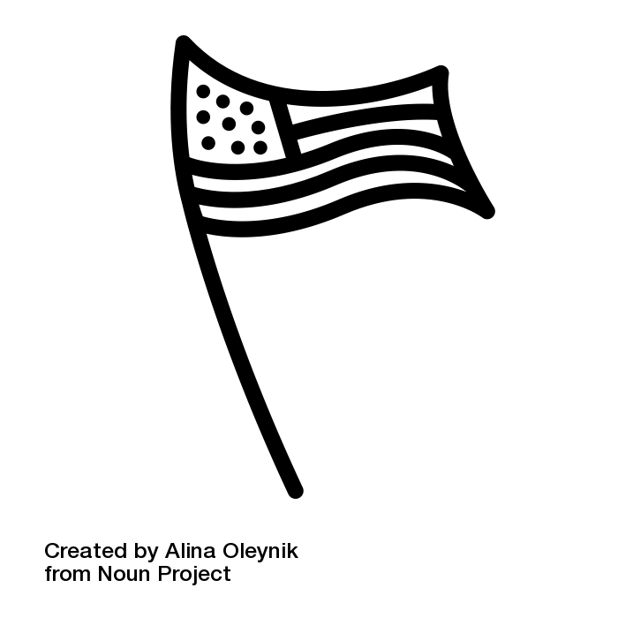

Who can use the OSG?
Anyone who is affiliated with a United States research institution (university or laboratory) can use the OSG.

Slide 5
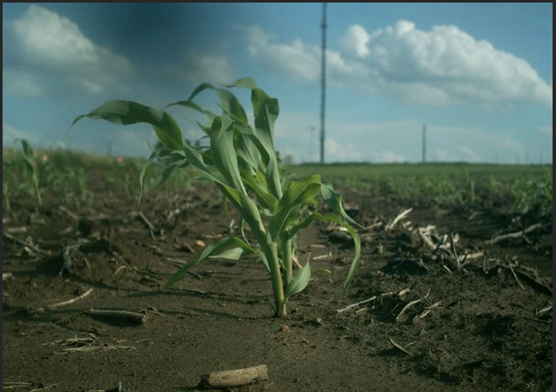
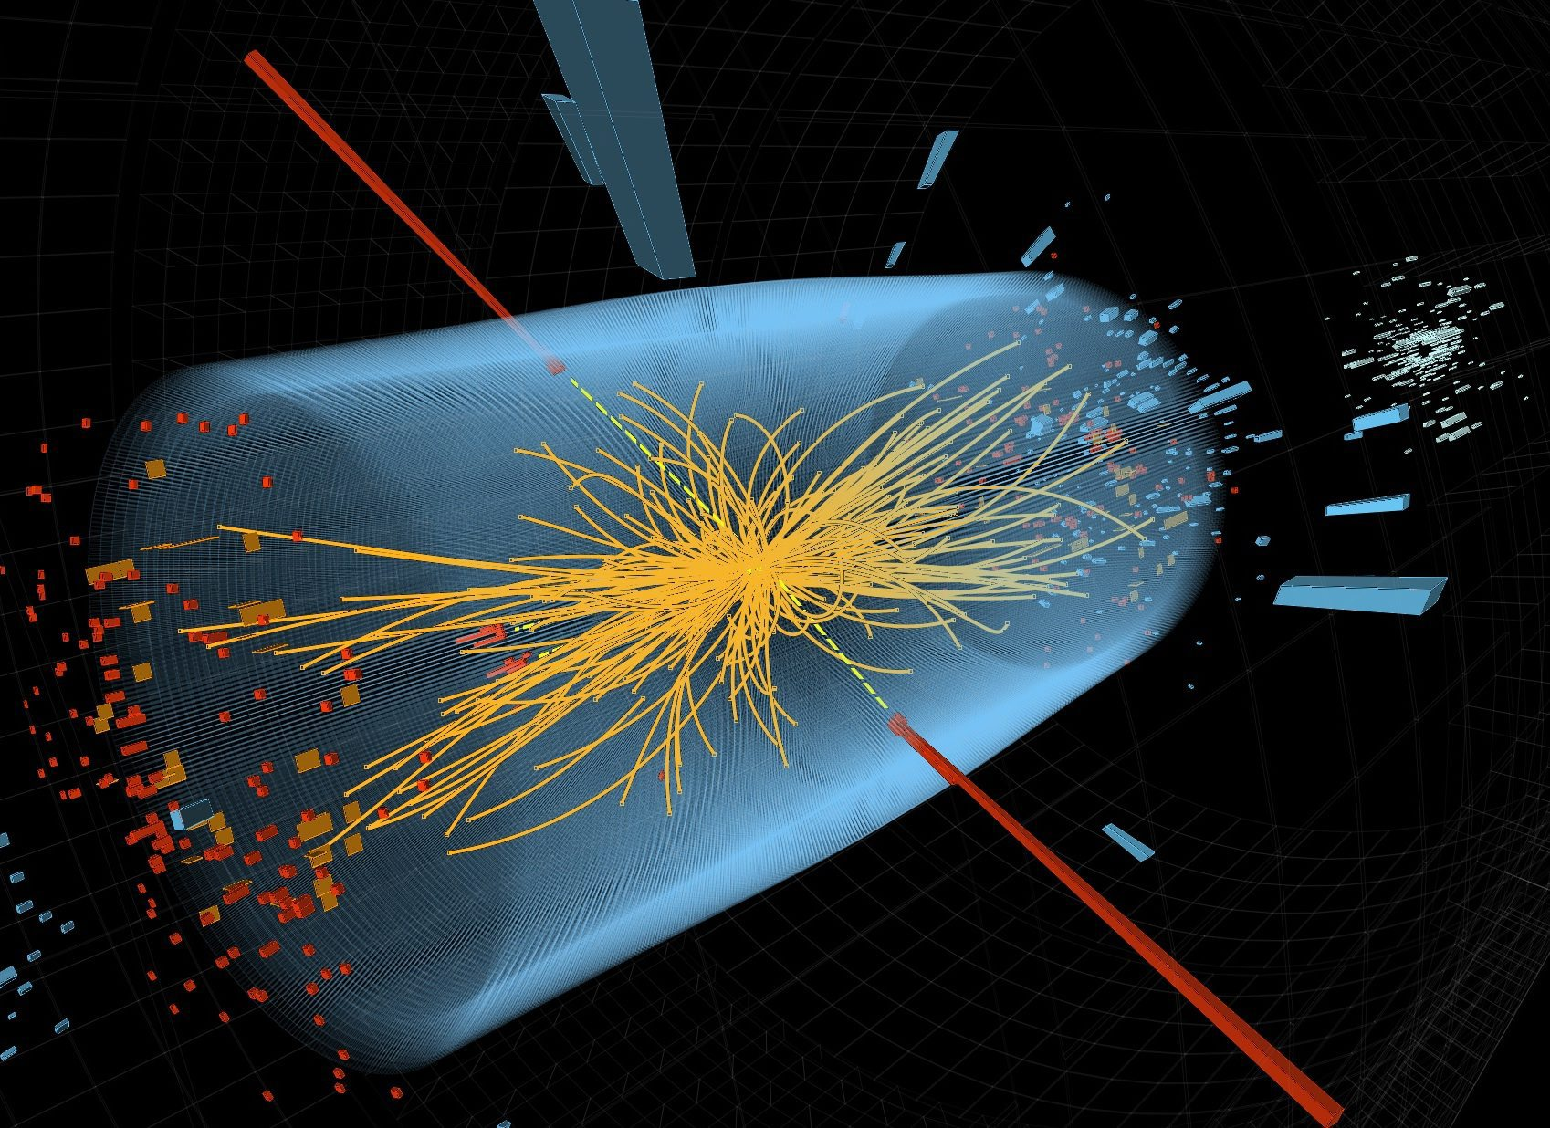
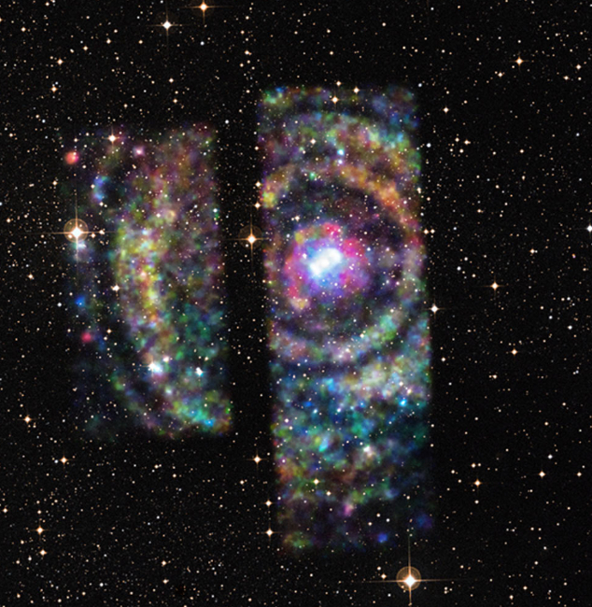
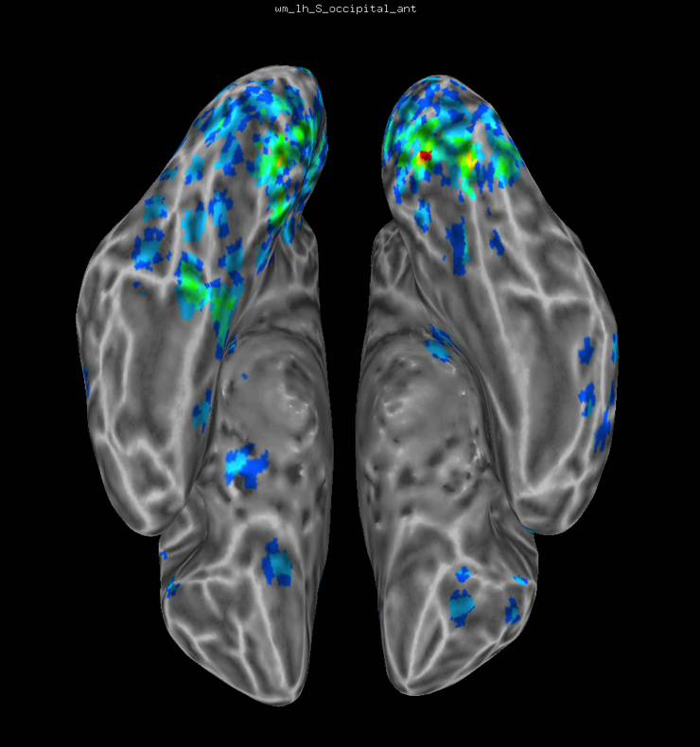
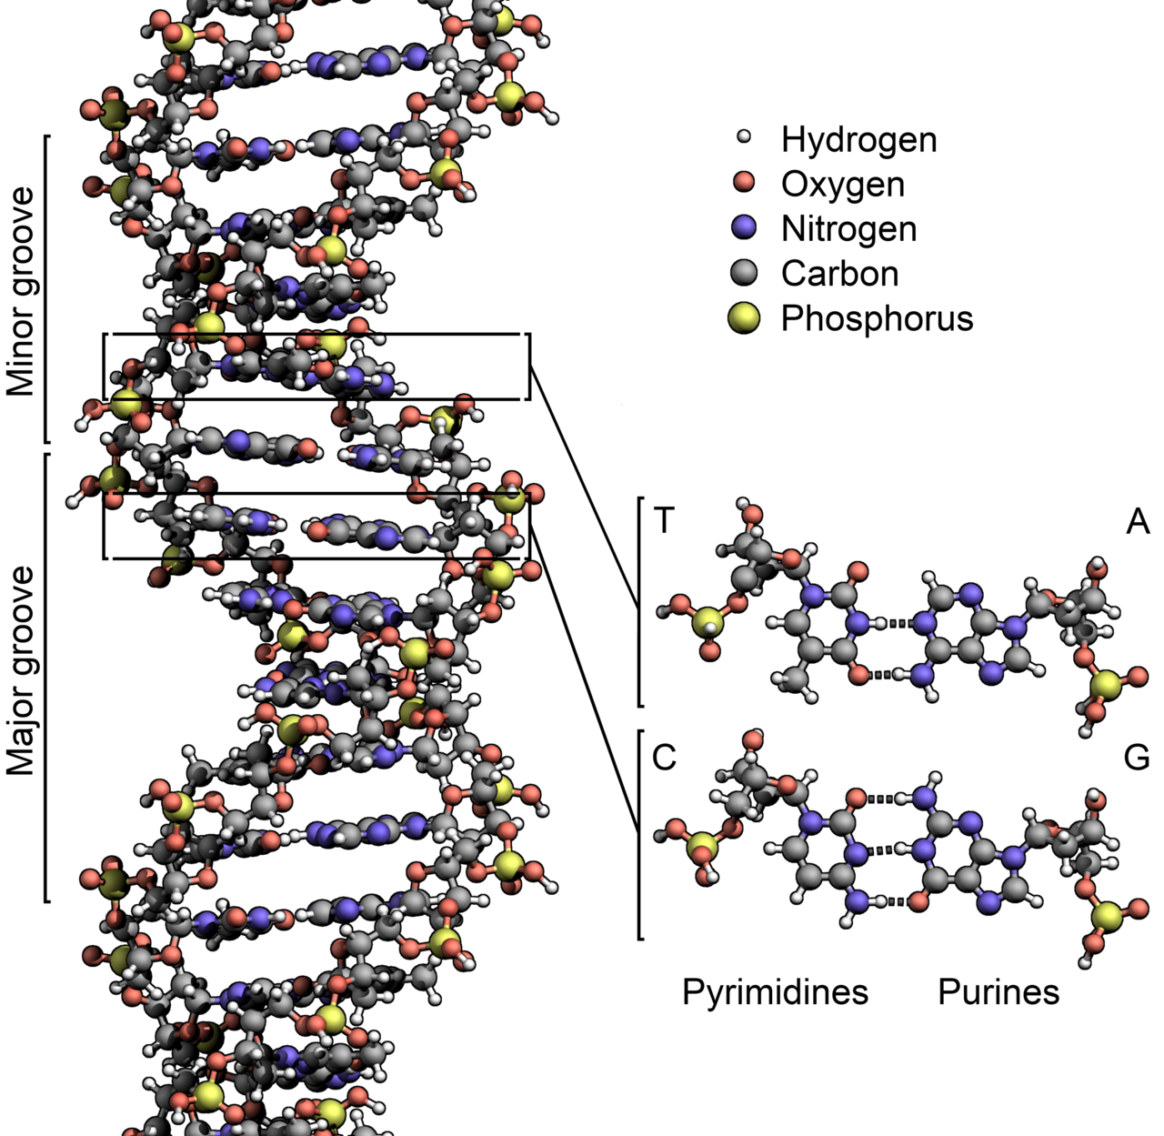
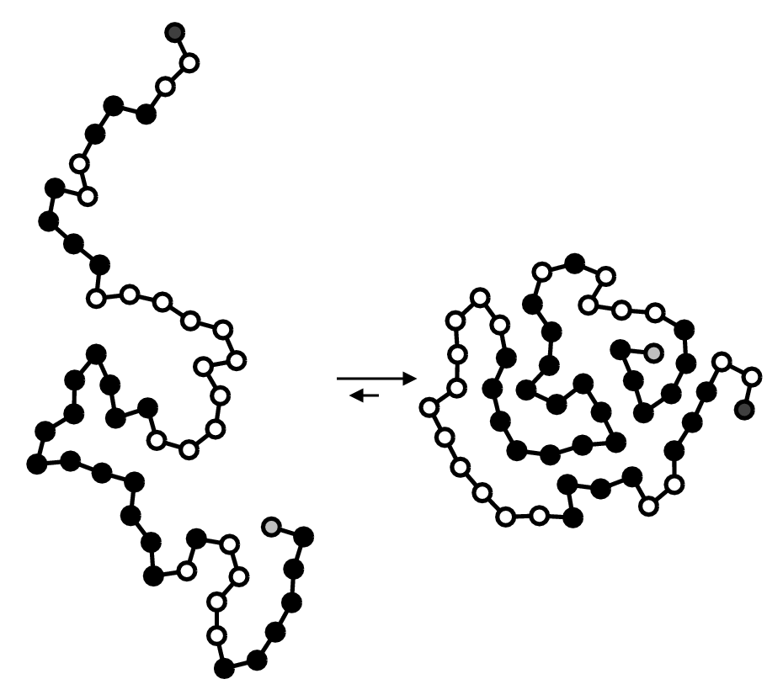
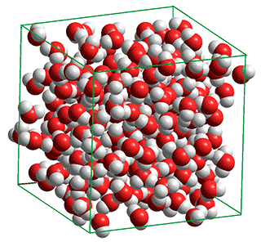
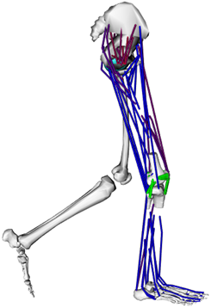
What research can use the OSG?

Slide 6

What are the benefits of using OSG?
Compute
Capacity!
thousands - millions of compute hours/year

Slide 7
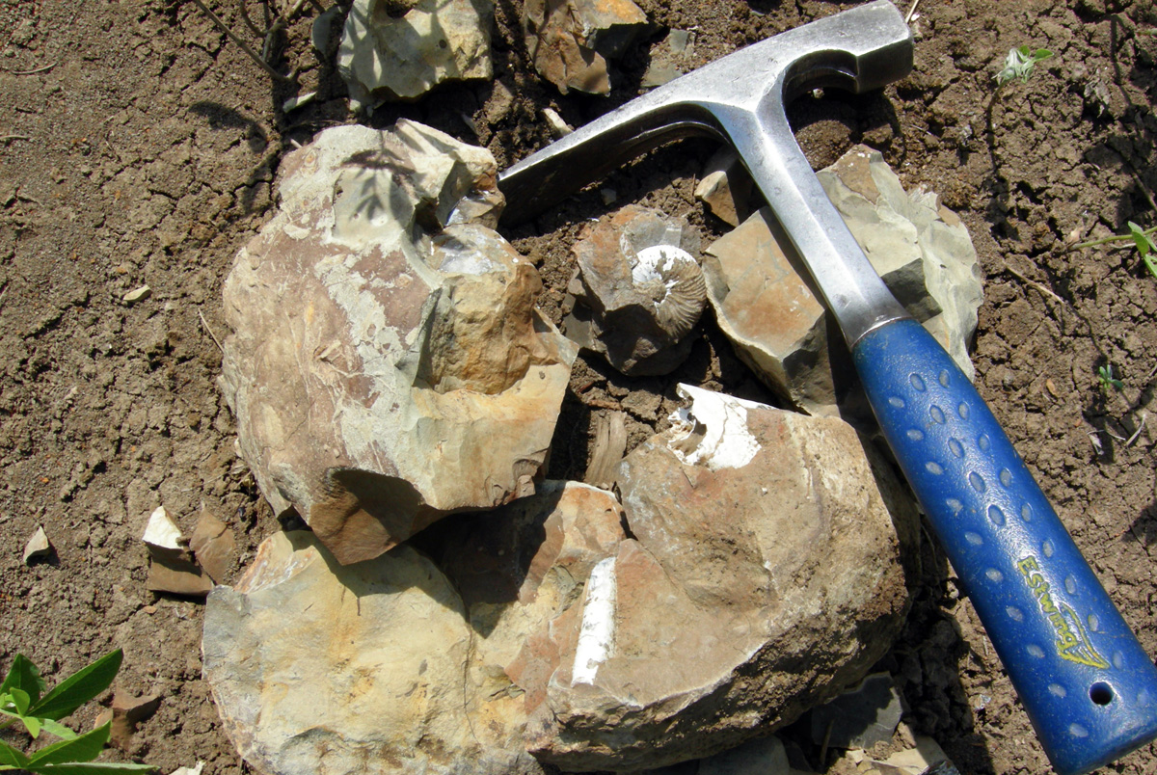
Is the OSG right for me? Can you break your computation into many independent pieces?

Slide 8
Context: High Throughput Computing
The OSG is built on a “High Throughput Computing” (HTC) model.
HTC = concurrently run many small/medium, independent tasks
Goal is to use as many cpus as possible, maximizing work over a long period of time,
i.e., “how many protein structures can I analyze in a month”
not “how detailed can I make this weather simulation?”

Slide 9
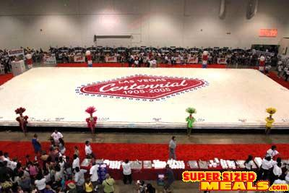
HTC: An Analogy
Q: How do you bake the world’s largest cake?

Slide 10
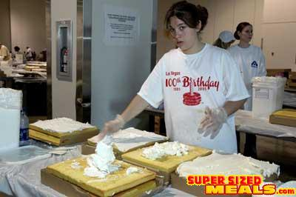
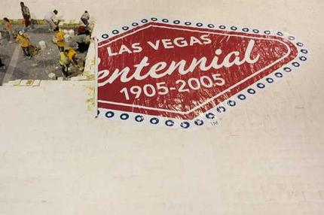
HTC: An Analogy
A: Bake many small cakes, in many ovens, then join.
This is the idea behind high throughput computing

Slide 11



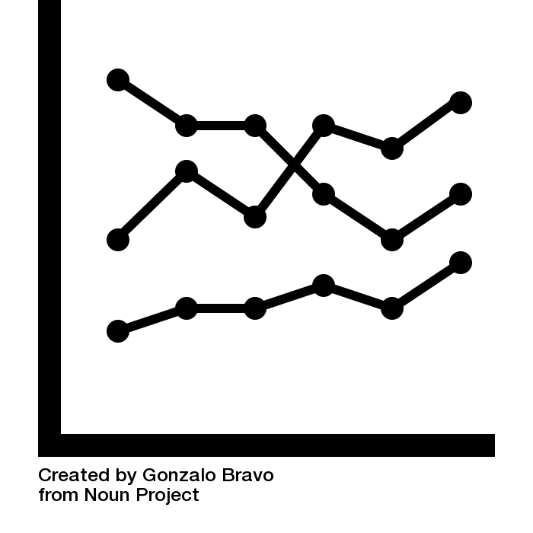
Moral of the story: break it up! Is your problem divisible into lots of “laptop-sized” pieces?
RNA/DNA sequence alignment | statistical model optimization | parameter sweep | multiple image/sample analysis

Slide 12
Image credits
https://map.opensciencegrid.org/
https://commons.wikimedia.org/wiki/File:DNA_Structure%2BKey%2BLabelled.pn_NoBB.png
Colin Smith, Chris Cox, Edgar Spaulding, CMS/ATLAS
Beaker by Kiran from the Noun Project
Institution by Popular from the Noun Project
American Flag by Alina Oleynik from the Noun Project
Plant by Shastry from the Noun Project
atom by Arthur Shlain from the Noun Project
https://commons.wikimedia.org/wiki/File:BrokenConcretion22.jpg
DNA by Arafat Uddin from the Noun Project
Image by Shastry from the Noun Project
grid by Nawicon Studio from the Noun Project
Line Graph by Gonzalo Bravo from the Noun Project

